Slide 1
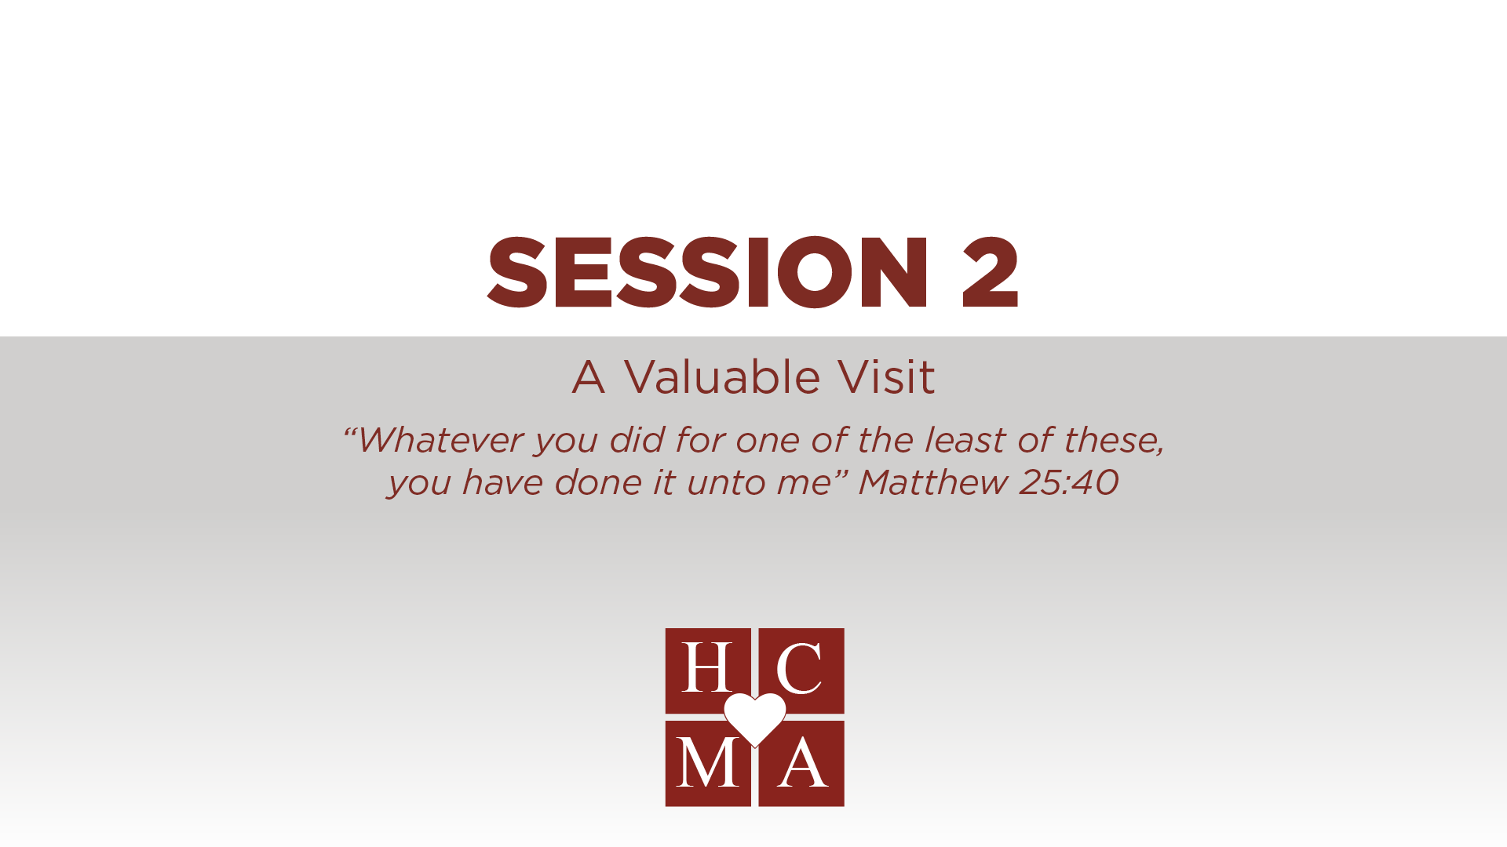

Slide 2
Optional: insert video or link

Slide 3
THOUGHTS & REFLECTIONS
What is the key take away for you in this video?
What is one area that you need to improve in, as it relates to visiting someone who is sick?
How have you experienced God’s presence when visiting someone who is sick or hurting?

Slide 4
GROUP DISCUSSION
What are some things we do in a visit that goes contrary to what you heard?
What has been your experience, when someone visited you when you were sick?
What are some other things we can do, to make it a valuable visit?

Slide 5

BIBLICAL REFERENCES
Rejoice with those who rejoice, weep with those who weep. Romans 12:15
The Lord is near to the brokenhearted and saves the crushed in spirit. Psalm 34:18
You search out my path and my lying down and are acquainted with all my ways. Psalm 139:3
Therefore, we are ambassadors for Christ, God making his appeal through us. We implore you on behalf of Christ, be reconciled to God. 2 Corinthians 5:20

Slide 6
BIBLICAL REFERENCES
Which verse can you identify with the most? Why?
What is God’s Spirit prompting you to do?
What will you do this week to practice what you have learned?
Write an “I will statement” and share it with the person next to you.
“This week, I will”:

Slide 7
HELPFUL HINTS
Before talking to people about God,
talk to God about people.
Always ask permission to pray or share scripture.
Caring for others is not about you,
it’s about meeting their needs.

Slide 8


