Slide 1
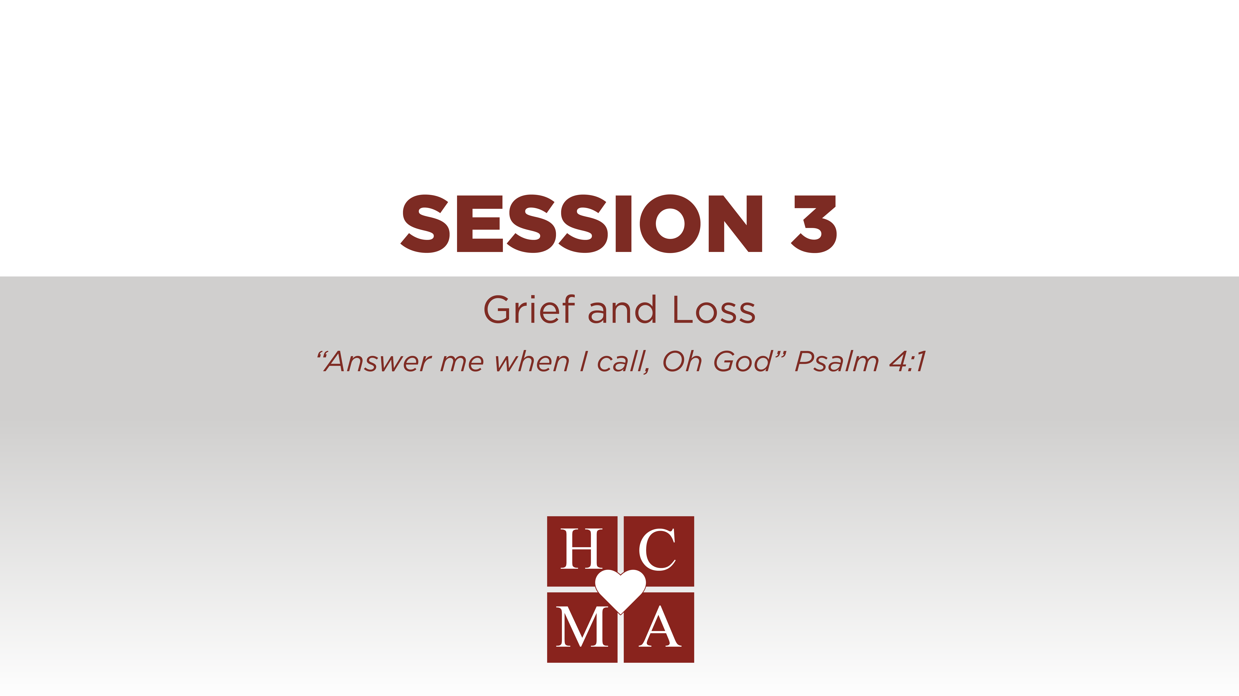

Slide 2
Optional: insert video or link

Slide 3
THOUGHTS & REFLECTIONS
What part of the video impacted you the most? Why?
What attitudes in care can you identify with most? Why?

Slide 4
GROUP DISCUSSION
As you think about grief and loss, how have you witnessed the stages of grief, in yourself or others? How did you handle it?
What is the most difficult part for you when dealing with death? How do we overcome that?

Slide 5

BIBLICAL REFERENCES
Answer me when I call, O God of my righteousness! You have given me relief when I was in distress. Be gracious to me and hear my prayer! Psalm 4:1
Your eyes saw my unformed substance; in your book were written, every one of them, the days that were formed for me, when as yet there was none of them. Psalm 139:16
Blessed are those who mourn, for they shall be comforted. Matthew 5:4
For to me to live is Christ, and to die is gain.
Philippians 1:21

Slide 6
BIBLICAL REFERENCES
Which verse can you identify with the most? Why?
What is God’s Spirit prompting you to do?
What will you do this week to practice what you have learned?
Write an “I will statement” and share it with the person next to you.
“This week, I will”:

Slide 7
HELPFUL HINTS
Hurting People Hurt People
Many people, when they are dying, feel untouchable. Ask to hold a hand.
A joy shared seems to double it, while a sorrow shared seems to halve it.
Grief is hard work and
should not be done alone.

Slide 8


