Slide 1
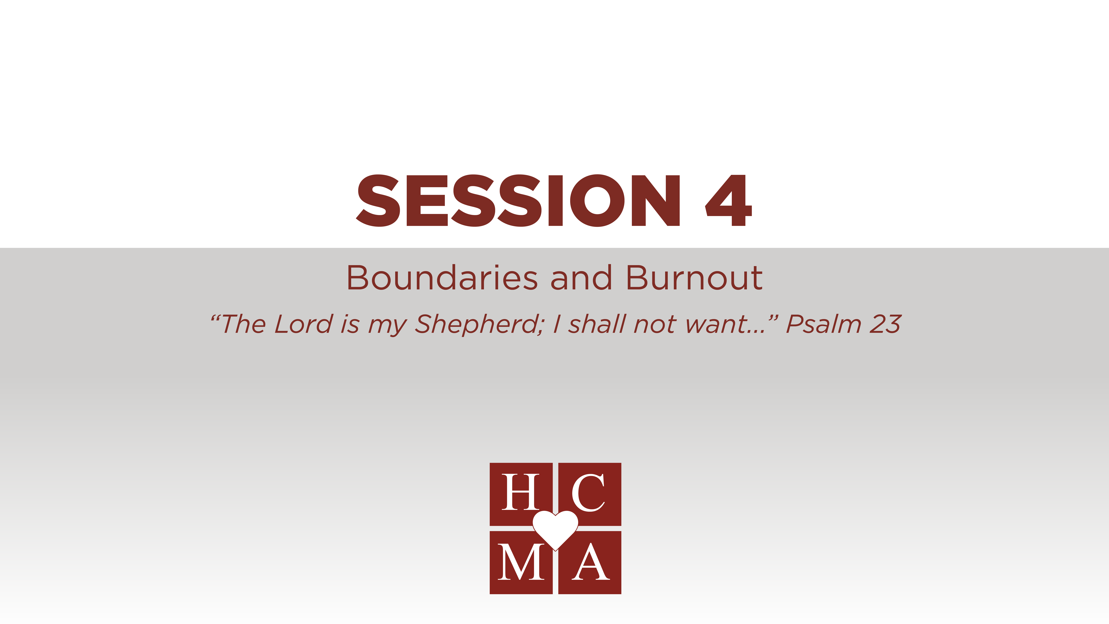

Slide 2
Optional: insert video or link

Slide 3
THOUGHTS & REFLECTIONS
What indications of compassion fatigue can you most identify with?
How do you replenish yourself to ensure that you don’t burn out?

Slide 4
GROUP DISCUSSION
What are some boundaries that you have established to guard your ministry?
How do you cope with the emotional toll of caring for others?
What are some ways we can support each other?

Slide 5

BIBLICAL REFERENCES
The Lord is my strength and my shield; in him my heart trusts, and I am helped; my heart exults, and with my song I give thanks to him. Psalm 28:7
The Lord is my shepherd; I shall not want. He makes me lie down in green pastures. He leads me beside still waters. He restores my soul. He leads me in paths of righteousness for his name's sake. Even though I walk through the valley of the shadow of death, I will fear no evil, for you are with me; your rod and your staff, they comfort me. You prepare a table before me in the presence of my enemies; you anoint my head with oil; my cup overflows. (continued…)

Slide 6
BIBLICAL REFERENCES
Surely goodness and mercy shall follow me all the days of my life, and I shall dwell in the house of the Lord forever.
Psalm 23
But they who wait for the Lord shall renew their strength; they shall mount up with wings like eagles; they shall run and not be weary; they shall walk and not faint. Isaiah 40:31
Come to me, all who labor and are heavy laden, and I will give you rest. Take my yoke upon you, and learn from me, for I am gentle and lowly in heart, and you will find rest for your souls. For my yoke is easy, and my burden is light.
Matthew 11:28-30

Slide 7
BIBLICAL REFERENCES
Which verse can you identify with the most? Why?
What is God’s Spirit prompting you to do?
What will you do this week to practice what you have learned?
Write an “I will statement” and share it with the person next to you.
“This week, I will”:

Slide 8
HELPFUL HINTS
Having an accountability partner will
help in ensuring that you won’t burn out.
Care but don’t carry. God loves people more than we ever could. He is more than capable.
When you care about others' problems
more than they do, that’s a problem.

Slide 9


